Slide 1

ProAdsorption
Designing tool for Industrial Adsorption Units

Slide 2

Project
Create, manage, and save your projects
Organize different adsorption unit designs

Slide 3

Case Study
Explore predefined case studies.
Real-world adsorption scenarios and examples.

Slide 4

Custom Isotherm Data
Input custom isotherm or adsorption data from experiment

Slide 5
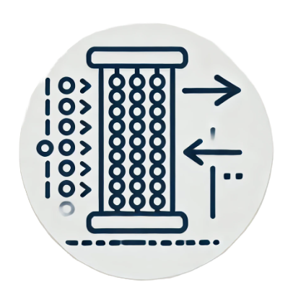
Adsorber Configuration
Configure adsorption columns and units.
Modify criteria for adsorption performance

Slide 6

Manuals & Tutorials
A detailed, step-by-step guide providing instructions
How to use or operate a particular product

Slide 7

Run Simulation
To operate a computer program that creates a simulated environment
To execute a simulation

